Slide 1
Baystate Banner:
LatinX Republican Support ELECTION
Ngozi Omatu, Song Xie, Matan Ziegel, Gil Lotzky, Annie Xie

Slide 2
What is our project about?
Background
Understand the voting patterns in the presidential and governors elections between 2014 - 2020
Methods
Collect demographic and election data from all tracts in Massachusetts
Apply linear regression models to analyze changes in Republican support
What we want to find out
Was there a shift in LatinX support for Trump between 2016 and 2020?
What is the breakdown of political support in terms of LatinX subgroups?
Which LatinX groups may have changed the way they voted?

Slide 3
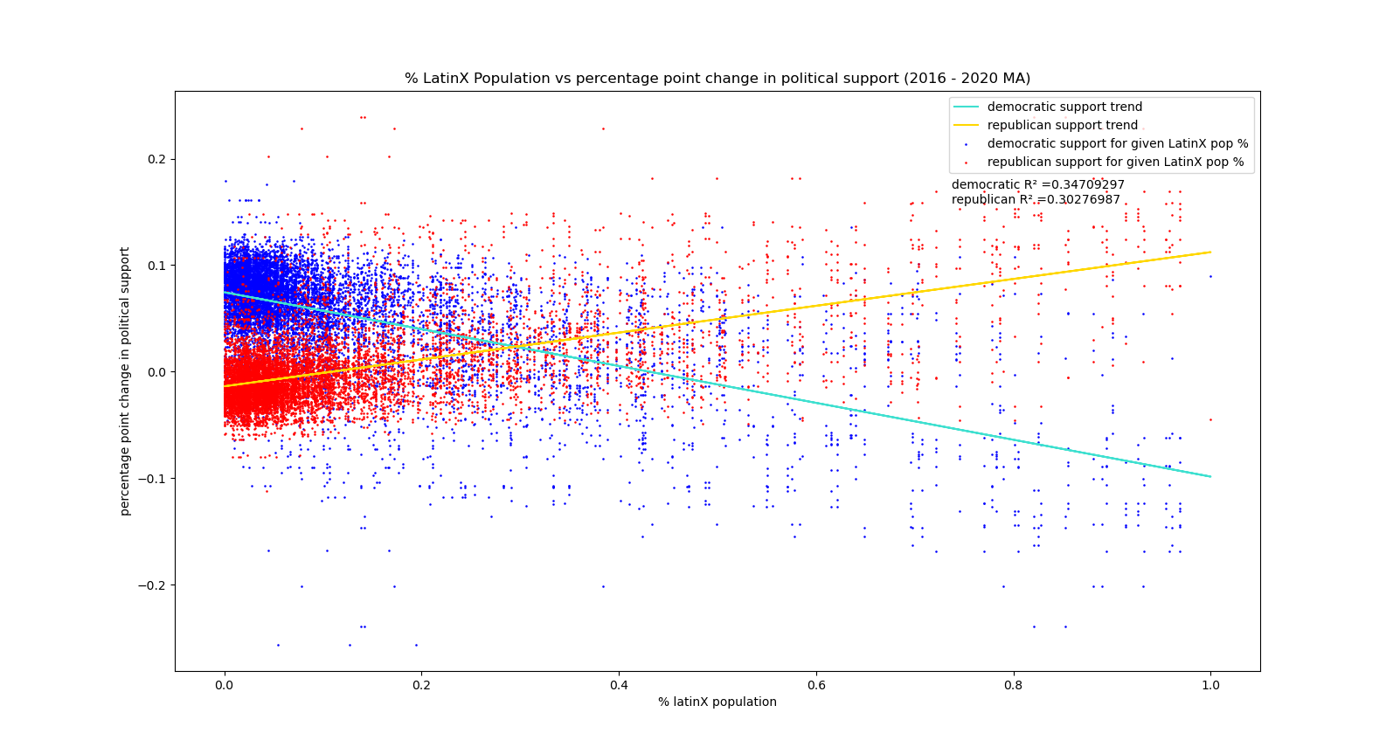
How has support for Trump shifted across the LatinX population
from 2016 to 2020? Was there a significant shift?
Analyzed changes in Republican support relative to the changes in the total LatinX population
Significant changes in support for Trump across the LatinX population

Slide 4
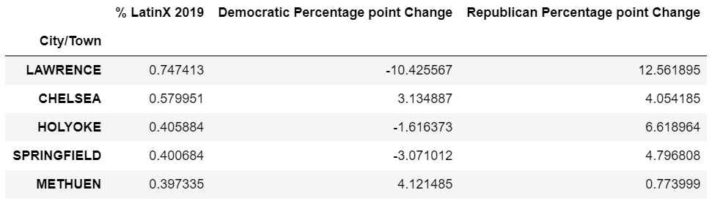
How has support for Trump shifted across the LatinX
population from 2016 to 2020? Was there a significant shift?
Top 5 towns with the highest LatinX population all saw increased Repubican support from 2016-2020

Slide 5
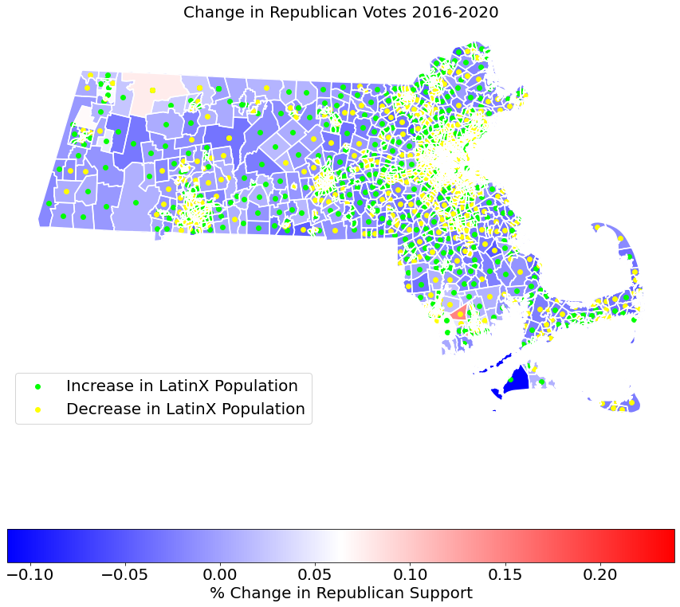
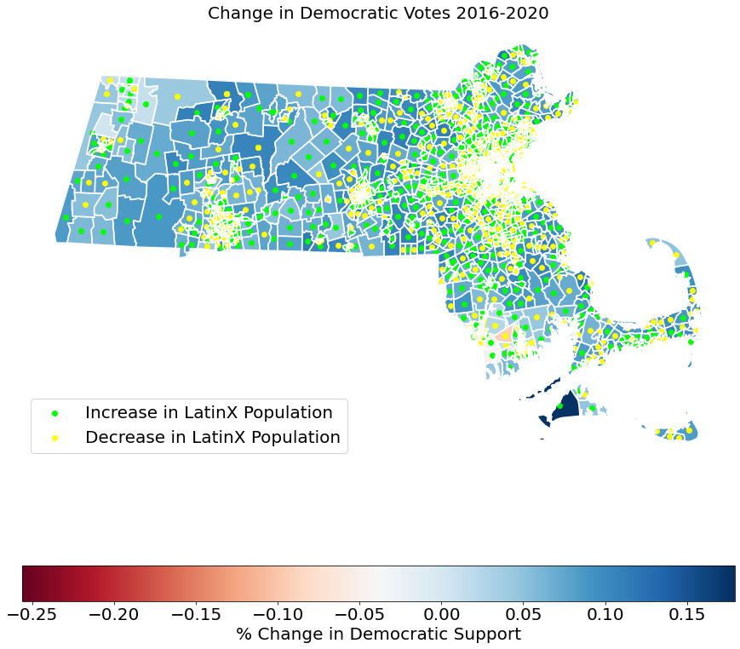
Change in Political Parties 2016-2020

Slide 6
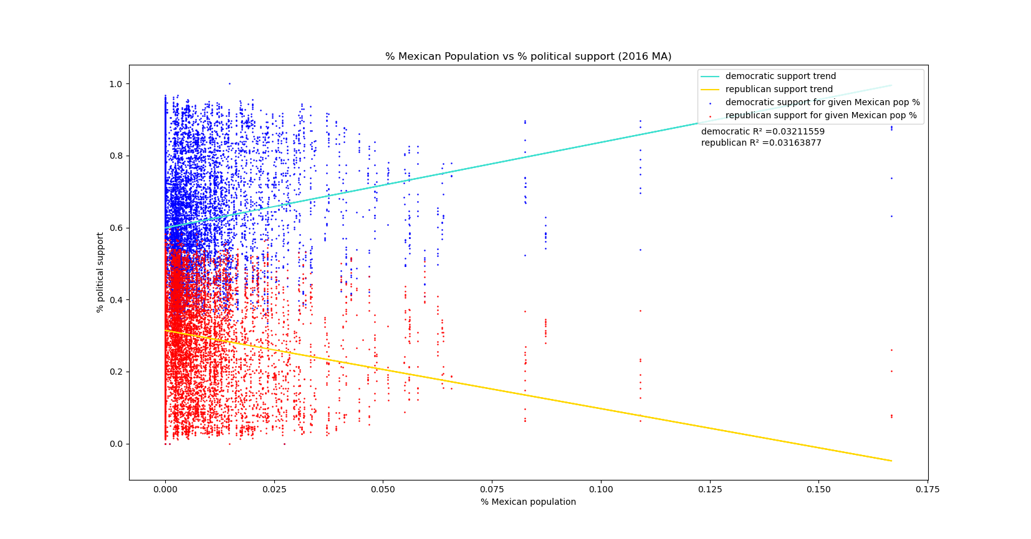
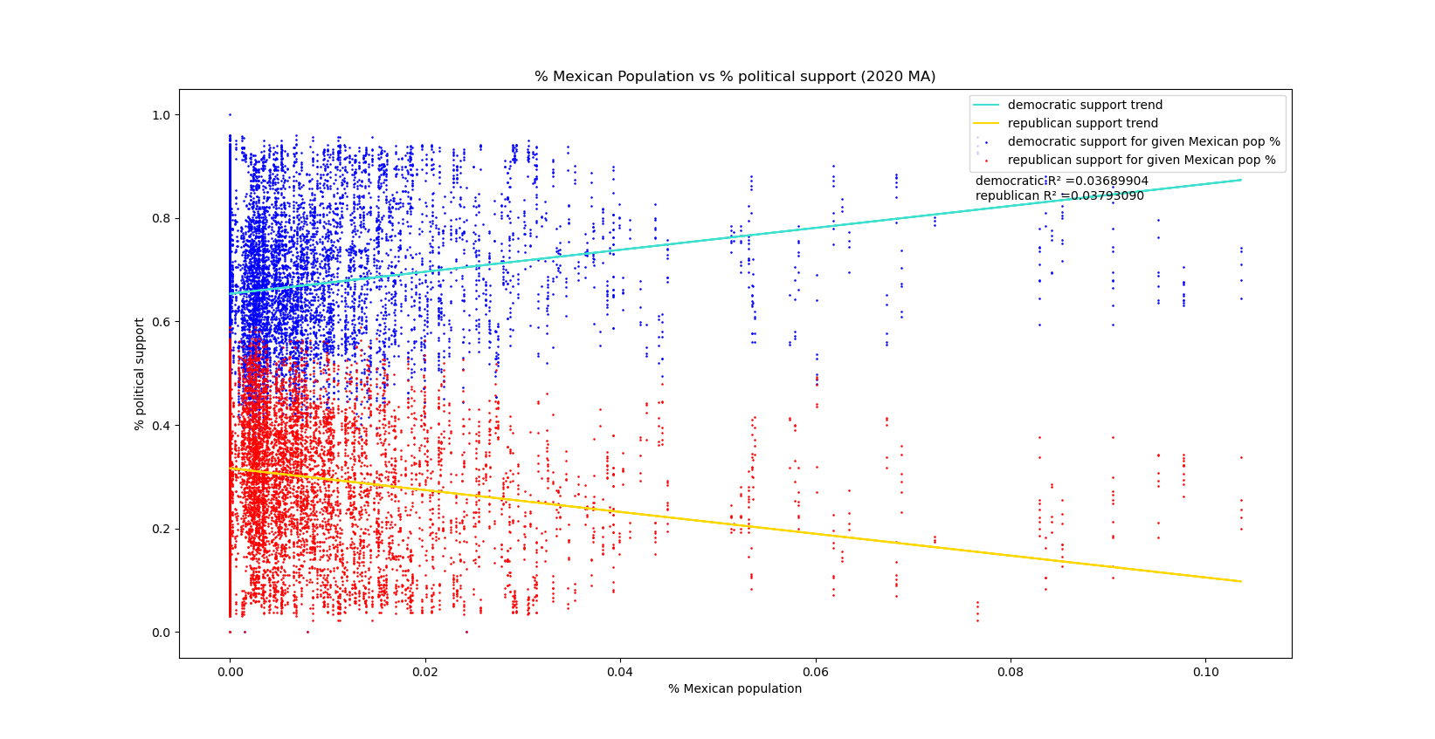
What is the breakdown of LatinX sub-groups in their support
for Democratic vs. Republican candidates?
Tracts with a higher Mexican population have more support for Democratic candidates than Republican candidates
From 2016 to 2020, Republican support increased and Democratic support decreased (Democratic slope decreased, Republican slope increased)

Slide 7
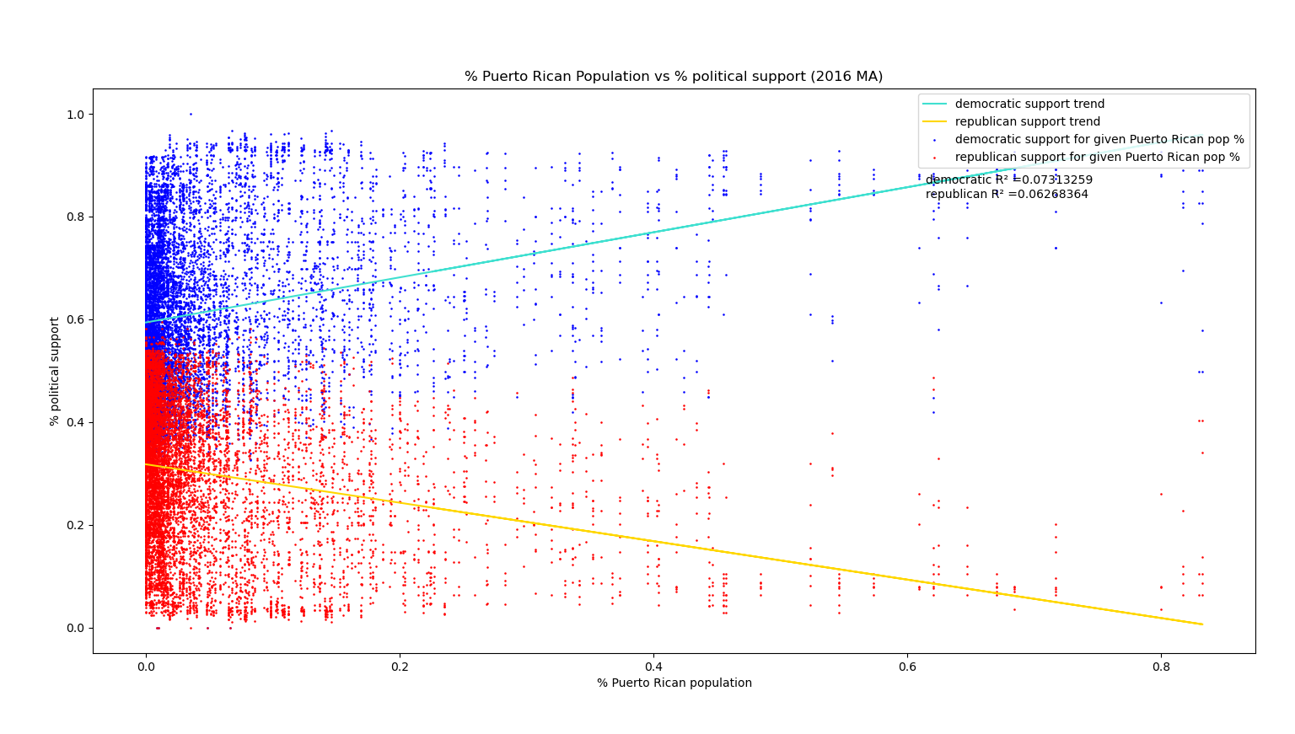
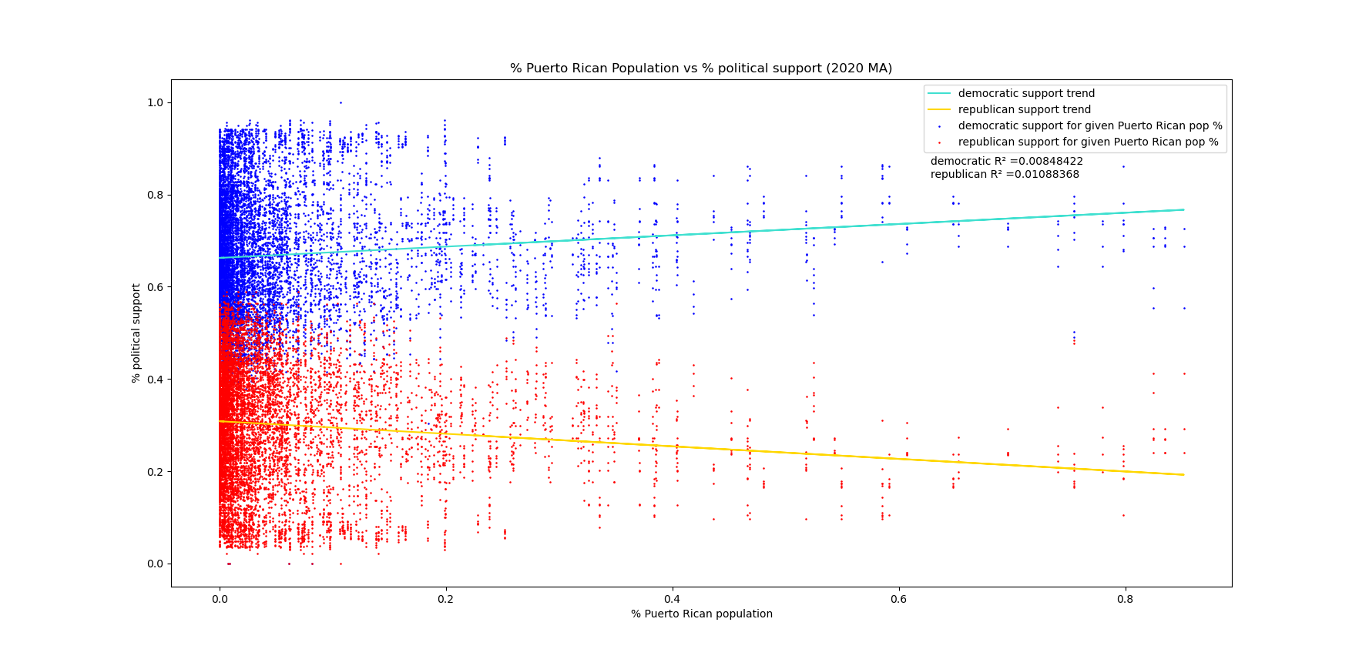
What is the breakdown of LatinX sub-groups in their support for Democratic vs. Republican candidates?
Tracts with a higher Puerto Rican population have more support for Democratic candidates than Republican candidates
From 2016 to 2020, Republican support increased and Democratic support decreased (Democratic slope decreased, Republican slope increased)

Slide 8
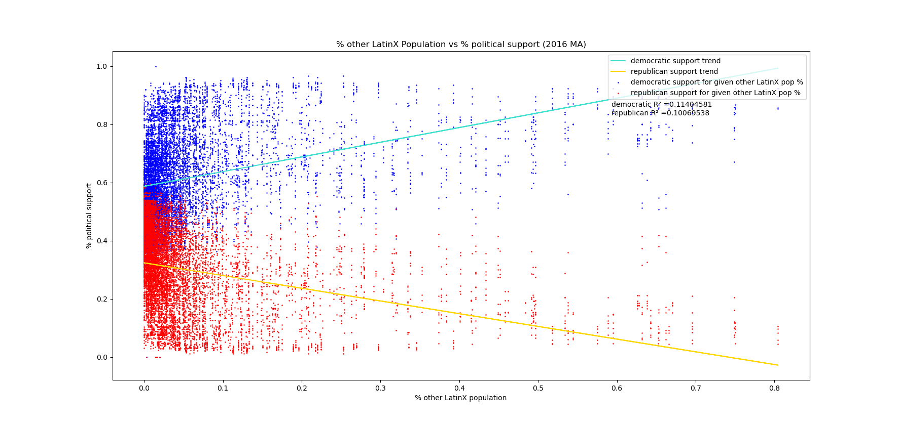
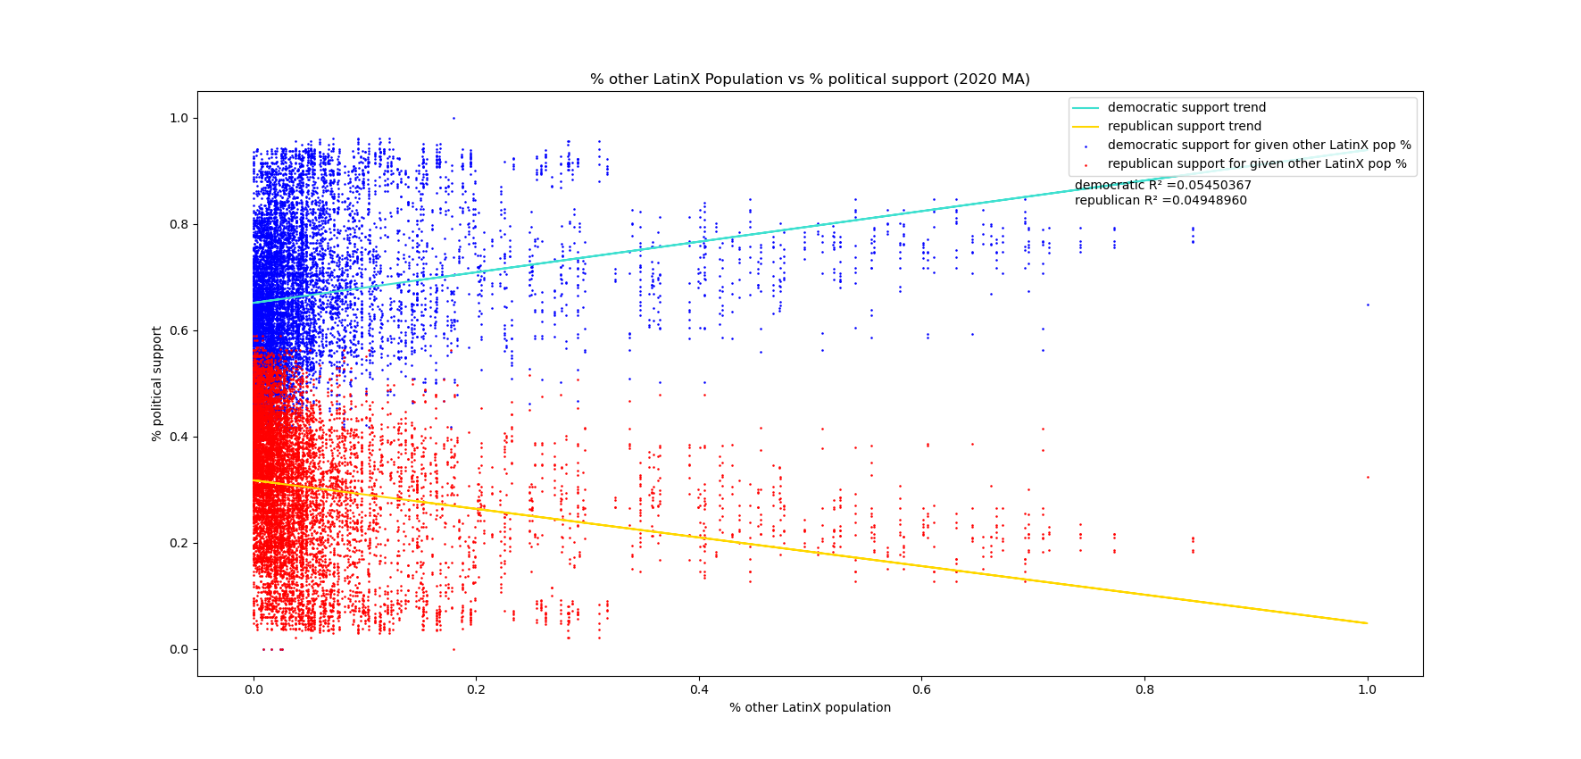
What is the breakdown of LatinX sub-groups in their support
for Democratic vs. Republican candidates?
Tracts with a higher other LatinX population have more support for Democratic candidates than Republican candidates
From 2016 to 2020, Republican support increased and Democratic support decreased (Democratic slope decreased, Republican slope increased)

Slide 9
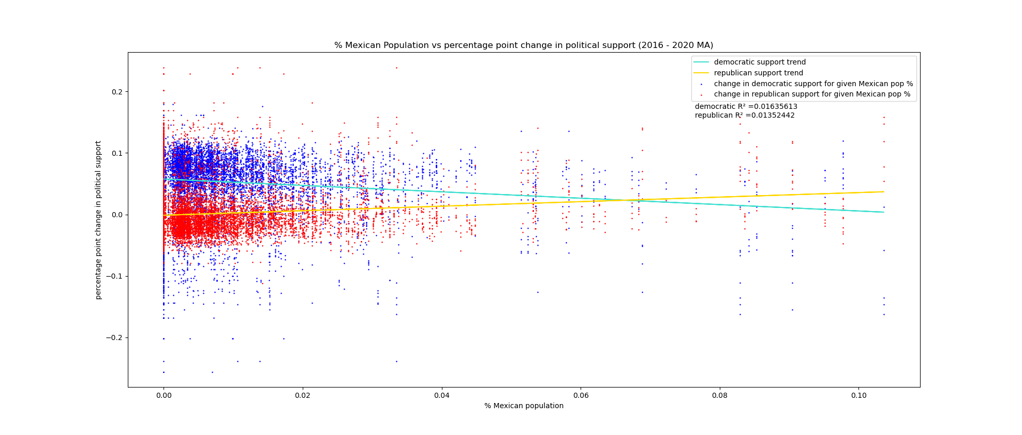
Which LatinX groups exhibited changes in their votes and
which groups remained the same?
Low correlation between % Mexican population and changes in Democratic and Republican support for each tract between 2016 and 2020
Tracts with higher Mexican populations saw a greater increase in Republican votes and a decrease in Democratic Votes between 2016 and 2020

Slide 10
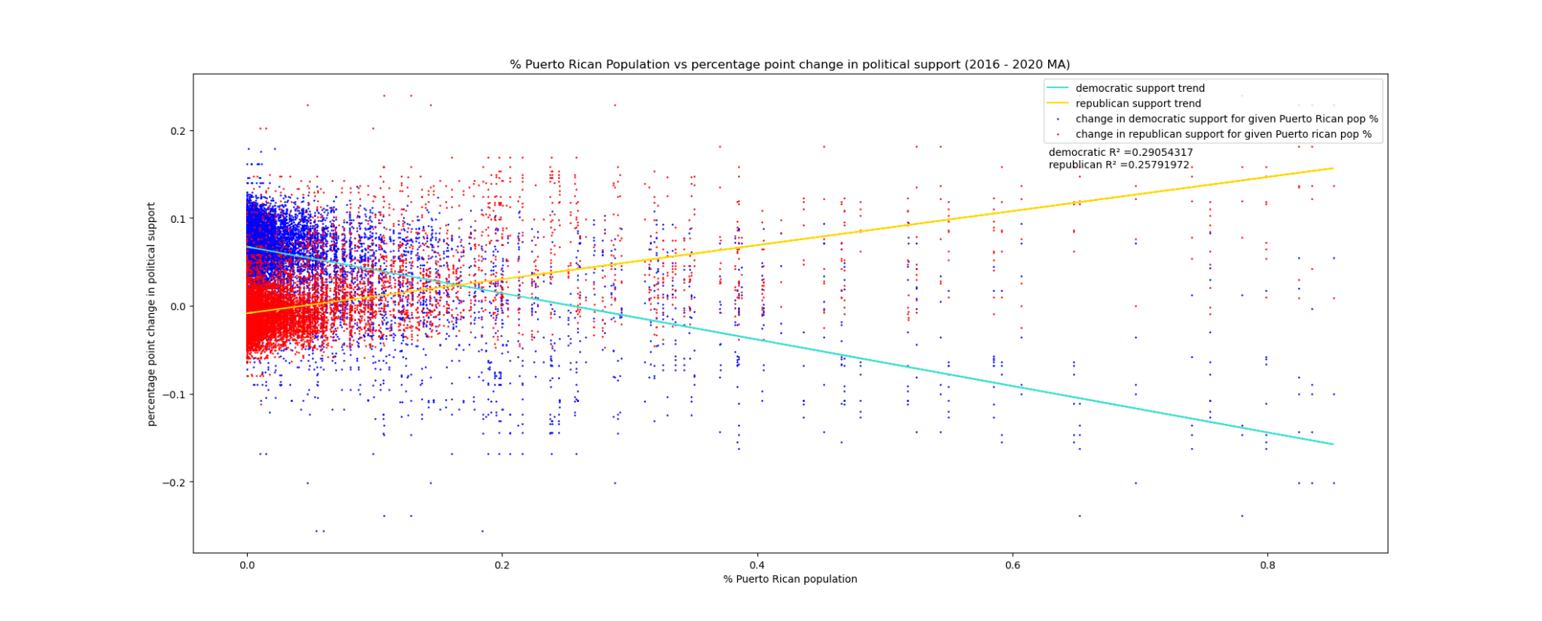
Which LatinX groups exhibited changes in their votes and
which groups remained the same?
Modest correlation between % Puerto Rican population and changes in Democratic and Republican support for each tract between 2016 and 2020
Tracts with higher Puerto Rican populations saw a greater increase in Republican votes and a decrease in Democratic votes between 2016 and 2020

Slide 11
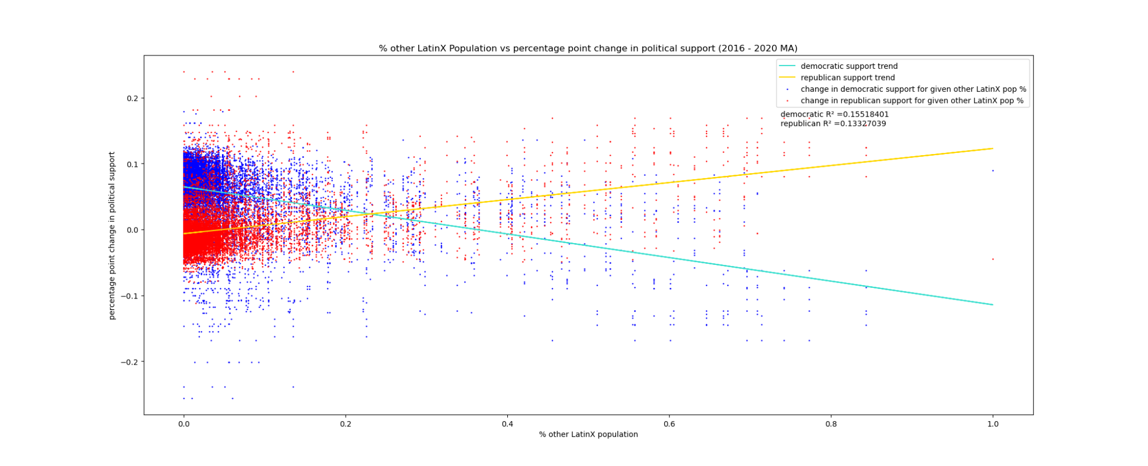
Which LatinX groups exhibited changes in their votes and
which groups remained the same?
Slight correlation between % other LatinX population and changes in Democratic and Republican support for each tract between 2016 and 2020
Tracts with higher other LatinX populations saw a greater increase in Republican Votes and a decrease in Democratic votes

Slide 12
Challenges
Cleaning datasets:
Unstructured datasets had many inconsistencies
Merging Demographic Data with Election Data:
Election data contains geospatial information associated with Precincts
Demographic data contains geospatial information associated with Tracts
Using GeoPandas and shapefiles
Apply geospatial information to our merged datasets through various geopandas functions
Merging our datasets with their geospatial information through the use of Shapefiles

Slide 13
Limitations/Next Steps
Limitations
No demographic breakdown of votes available
No specific data available for the LatinX populations
Only possible to make inferences on voting patterns by changes in LatinX demographics
Only similar available datasets is polling data which is not as accurate
Next Steps
Compare the pre-election polling data from 2016 - 2020 to the election results to assess the accuracy of the pre-election data
Analyze changes in voter patterns based on gender to see if there is any relationship between gender and political support

